Slide 1
40 meter DC RX Board Integration
REMEMBER: THIS IS NOT PLUG-AND-PLAY ELECTRONICS!
YOU ARE MAKING SOMETHING NEW.
WE OFTEN HAVE TO WORK WITH THE GEAR TO GET IT GOING.

Slide 2
Some teams have built all four boards…
… today they will move into the final assembly phase.
… other groups should continue to build.
Our goal is to get all receivers finished. But time is getting tight!
The end of the school year is approaching.

Slide 3
THE SHELF OF SHAME
Most homebrewers have one.
This is where unfinished or non-working projects end up.
Don’t let your receiver end up there!

Slide 4
Take a picture of this slide! We can help you finish the receiver!
Your skills have improved! You can work on the boards even when we are not here.
We will leave all the needed parts. And consult the shared drive for info.
You can contact us if you have questions, or problems with the receiver.
Dean KK4DAS@gmail.com Bill bill.meara@gmail.com.
Be sure to cc Ms. Kucko on all e-mail: klkucko@fcps.edu
We are happy to consult with you. We may be able to come back later in the year for more finish-up sessions.

Slide 5
We will issue Certificates of Completion for those groups who finish their receivers.
And we will present awards for the best receivers.

Slide 6
Walter KA4KXX in Orlando – A Reward
Our friend Walter in Orlando has offered a reward of $500 to the first member of this group to check into the 40 Meter CW (Morse Code) “Sunrise Net” with a simple transmitter that he designed.
You can do this with your current licenses.
If you are interested, get in touch with us.

Slide 7
FINISH THIS!
Don’t be the person who almost finished a school project.
This is your chance to really build a receiver.
You are close!
Finish it!
Let’s get it done!

Slide 8
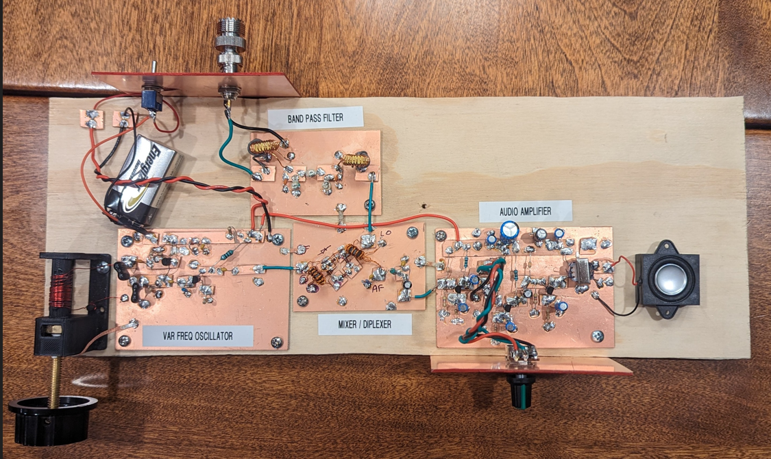
Assemble the board like Dean did with his:
-- Solder the boards
together with solder wick.
-- Power the VFO and
AF Amp.
-- Inputs close to outputs.
-- Don’t worry about front
or back panels for now.
-- We can now test the
whole thing.

Slide 9
Antennas and listening
You will need is an antenna. The antenna is important. We recommend a simple wire antenna that can be strung from a bedroom window or in an attic. See: (68) An Antenna for the TJ 40 Direct Conversion Receiver – YouTube
We have the wire you will need for the antenna.
Be sure to stay completely away from power lines. Otherwise, antenna work can be extremely dangerous.
Then you can take the receivers home and listen to the 40 meter band with it. You can pass it around to other members of your team. Or build additional receivers! You can build them!
We will give you a list of things you can do with the receiver.

Slide 10
The antenna is simple! Something like this. (68) An Antenna for the TJ 40 Direct Conversion Receiver - YouTube

Slide 11
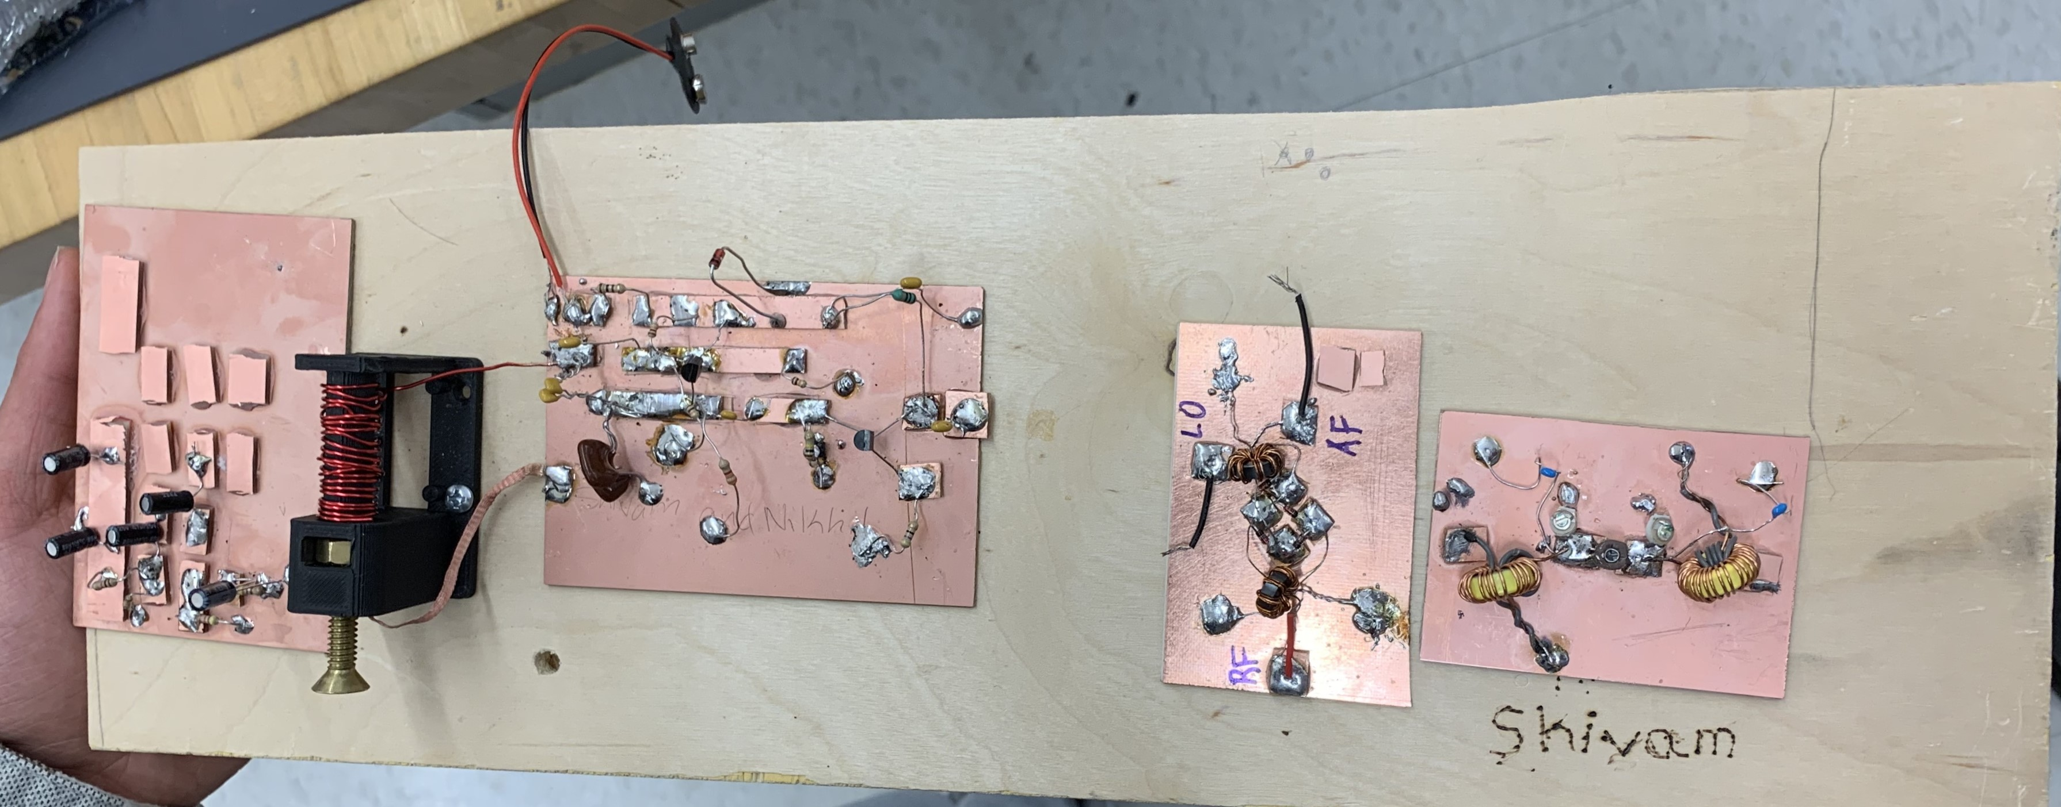
The important thing is….
You will have built a ham radio receiver!
You will have done something that most hams NEVER do!

